Slide 1
E – Commerce website
Under guided by:- Mr Rajesh Kumar

Slide 2
INTODUCTION
Electronic commerce is the buying and selling of goods and services, or the transmitting of funds or data, over an electronic network, primarily the internet.
E-commerce is powered by the internet. Customers access an online store to browse through and place orders for products or services via their own devices.

Slide 3
Technology and tools used
HTML :- HTML stands for hyper text markup language it is the standard markup language for creating web pages.
CSS:- Cascading style sheets is a style sheet language used for describing the presentation of a document written in a markup language such as html.

Slide 4
VISUAL STUDIO:- Visual studio is an integrated development environment from microsoft. It is used to develop computer programs including websites, web apps, web services and mobile apps.

Slide 5
Types of e- commerce
Business to business
Business to consumer
Consumer to consumer
Consumer to business

Slide 6
1. Business to business
E-commerce refers to the electronic exchange of products, services or information between businesses rather than between businesses and consumers.
2.Business to consumer
Is the retail part of e-commerce on the internet. It is when businesses sell products, services or information directly to consumers.

Slide 7
3. Consumer-to-consumer
Is a type of e-commerce in which consumers trade products, services and information with each other online.
4. Consumer to business
Is a type of e-commerce in which consumers make their products and services available online for companies to bid on and purchase.

Slide 8
ADVANTAGE OF E - COMMERCE
Availability:- It tells the availability of the product which customer prefer to purchase it.
Easy accessibility:- To get information easily with the help images, text etc.
Speed of access:- To loading the content on a URL.
Lower cost:- Showing low price product to customer.

Slide 9
DISADVANTAGE OF E - COMMERCE
Wait time :- Taking to much time for delivery.
Security:- It may be not secure the customer account and the data.
Limited product experience:- Don’t have product in stock or don’t know about any particularly product detail.

Slide 10
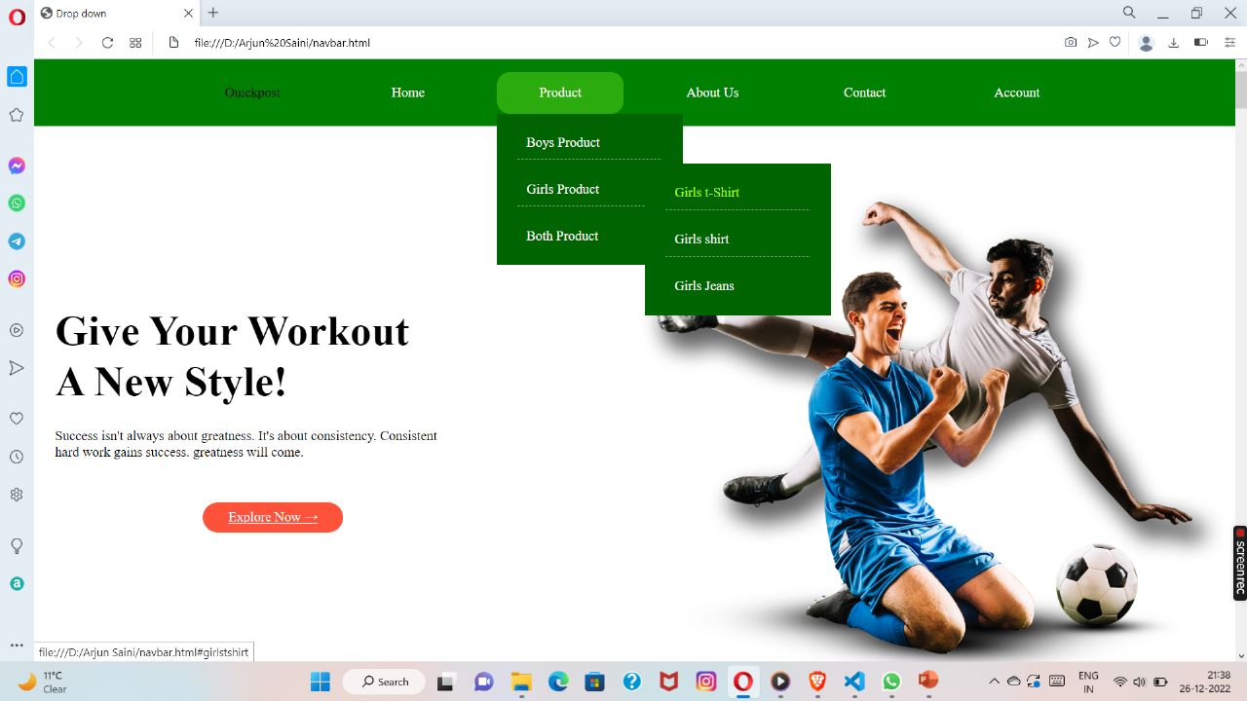
HOMEPAGE

Slide 11
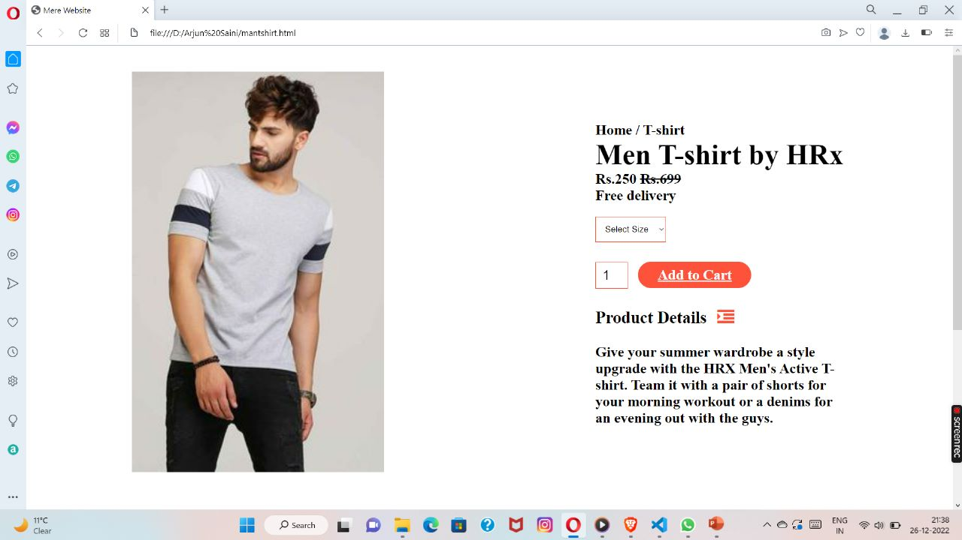
PARTICULAR PRODUCT IMAGE

Slide 12
conclusion
E- commerce is a fast growing market and in this society people are getting lazier and are now doing more shopping online.
However, data security and the possibility of fraud are still a major concern.
E commerce support the relationship between the customers and companies such as e mail

Slide 13




TEAM MEMBER
NITESH KUMAR
Mohd Harish
ARJUN
Aayush Kumar

Slide 14
THANK YOU

